Slide 1
Architecture and Screens
Shashank Dixit

Slide 2
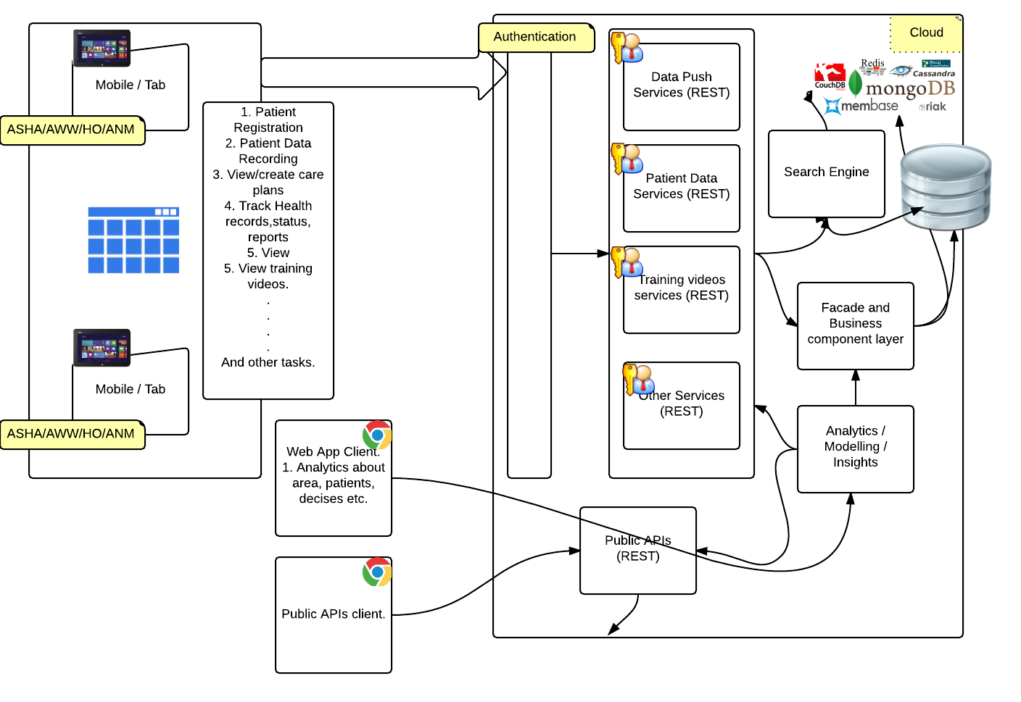

Slide 3
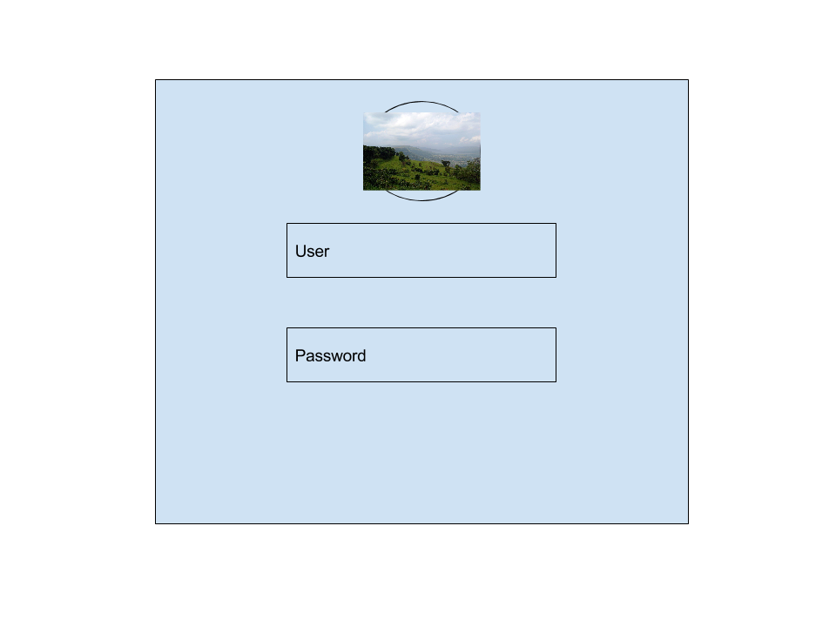
Login Screen

Slide 4
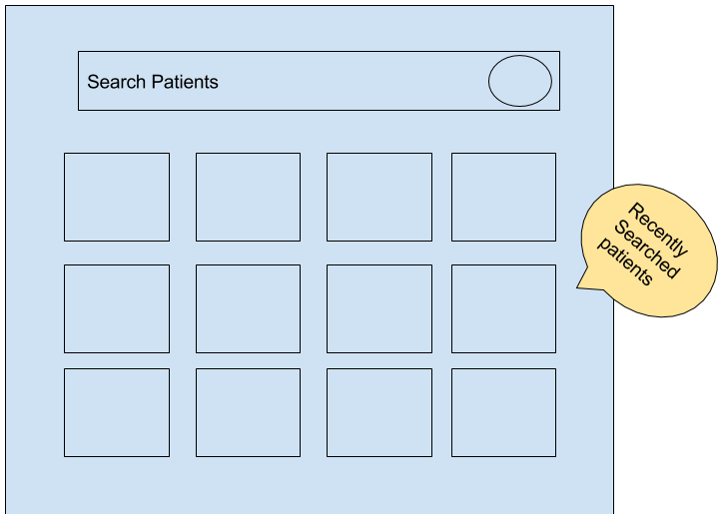
Patient Search

Slide 5
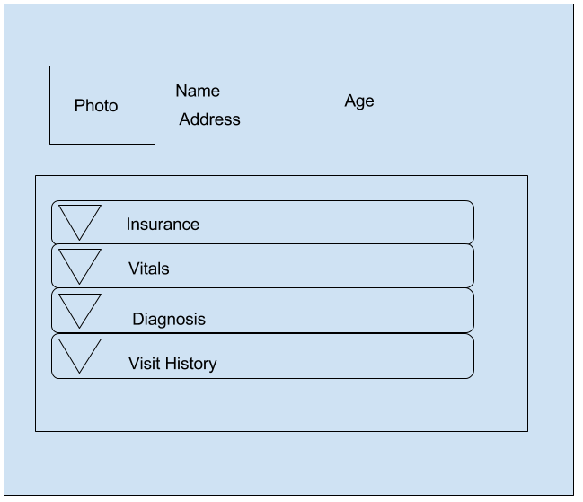
Patient Details

Slide 6
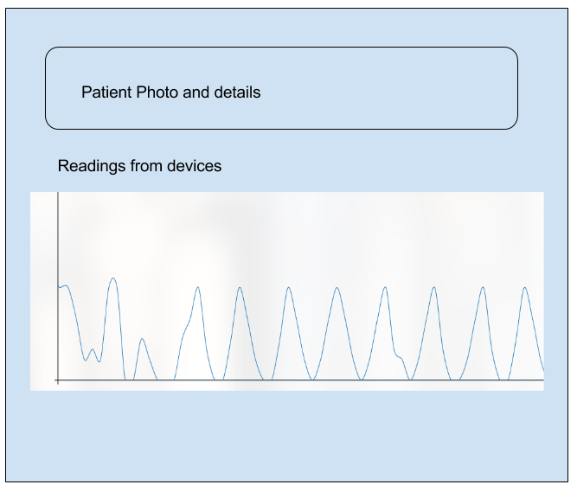
Patient Monitoring

Slide 7
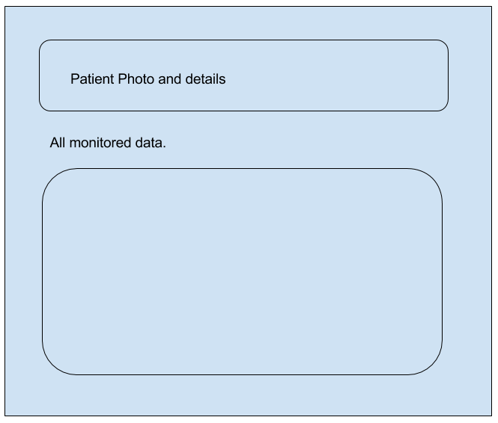
Patient Monitoring – Data from all the devices

Slide 8
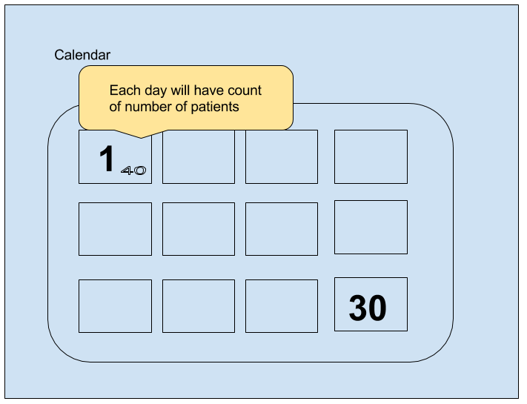
Calendar

Slide 9
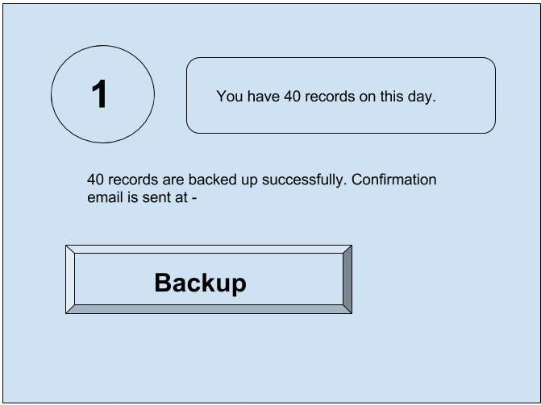
Day

Slide 10
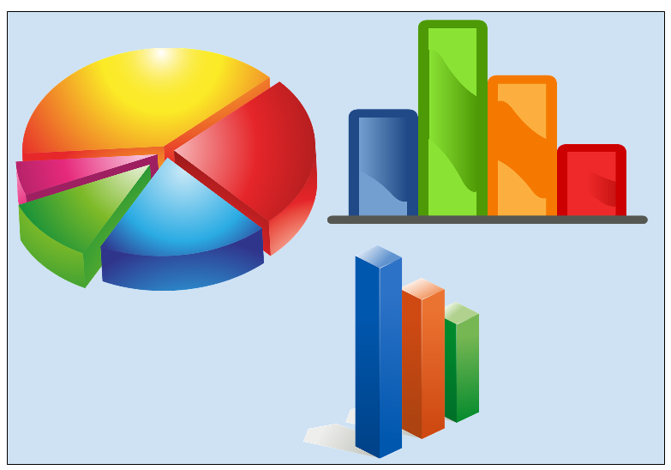
Health Officer’s Console
Various Dashboards

